Slide 1
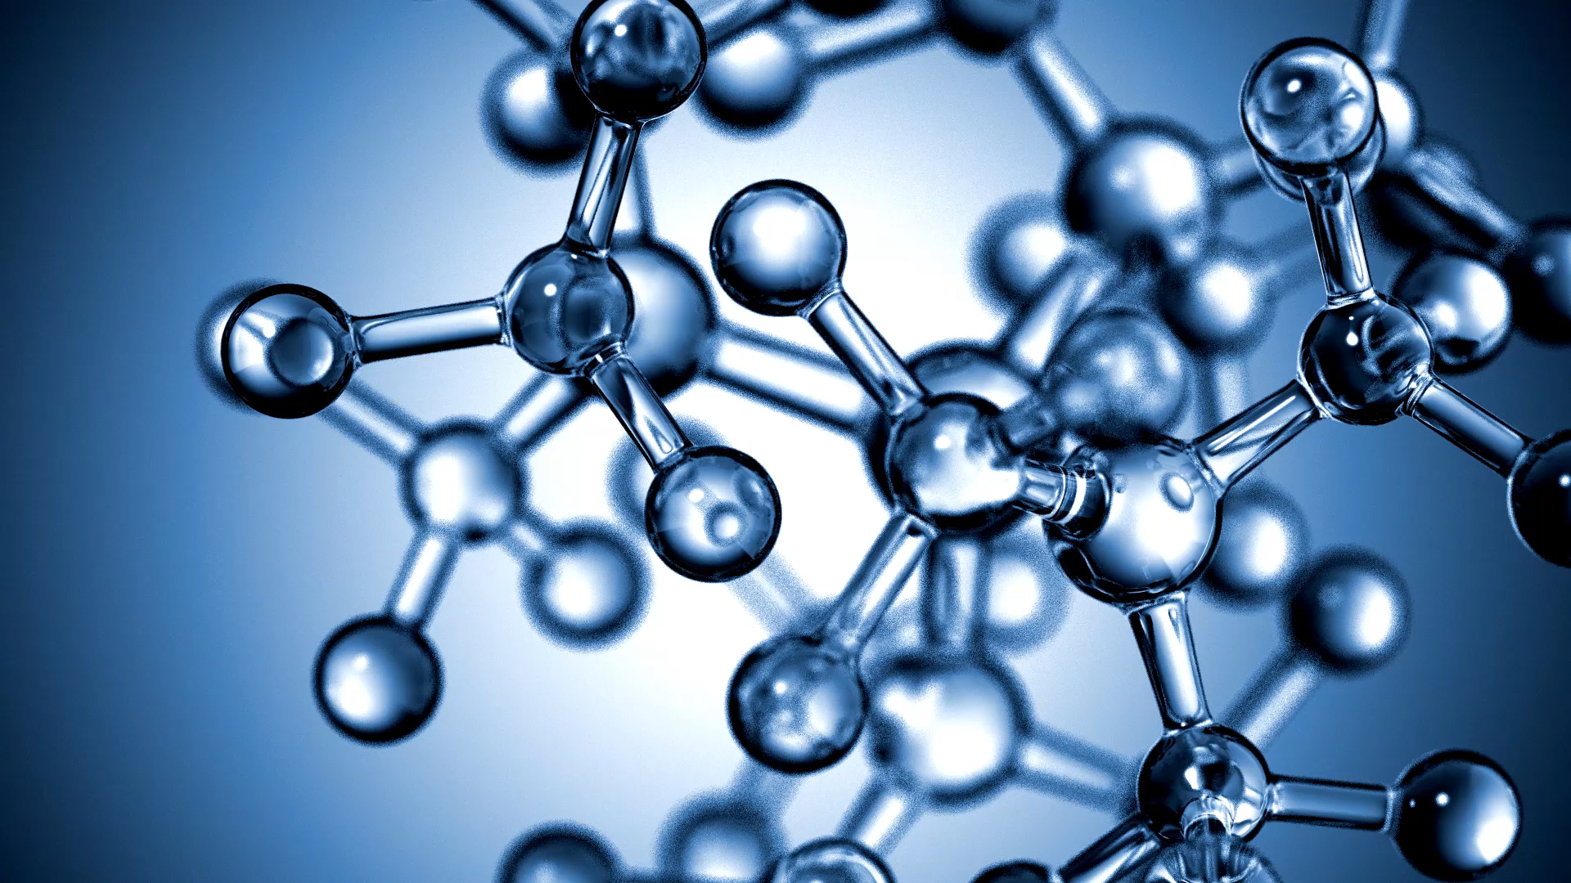
TetraScience
Data Onboarding Presentation
Harness the value of scientific data

Slide 2
TetraScience’s Scientific Data & AI Cloud
Ingest and centralize life sciences data in the cloud
Parse and transform scientific data into accessible web & SQL friendly formats and interfaces, enabling usage via programmatic and BI tools
Automate the movement of scientific data to strategic targets, like Electronic Laboratory Notebooks (ELNs) and Laboratory Information management systems (LIMS)

Slide 3
Key Components
Tetra Integrations
Data Harmonization and Engineering
Data Access and Management
GxP support, Administration and, Security

Slide 4
Integration Components
Tetra Agents
Tetra Connectors
Tetra Data Pipelines

Slide 5
Supported Integrations
Experiment Context and Design Data Integrations
Benchling, IDBS E-Workbook, Revvity Signals, Dotmatics Entity Registration, Dotmatics ELN, LabVantage, Titian Mosaic
File Sharing and External Collaborator Data Integrations
Box, Egnyte, Amazon S3, Microsoft SharePoint, Snowflake
Instrument Data Integrations
AGU Sm@rtLine Data Cockpit (SDC), Cytiva UNICORN, HighRes Biosolutions Cellario, Windows-based instruments, KEPServerEX, Simple instruments e.g. Siemens, Sotax etc., Mettler Toledo LabX, Solace PubSub+, Thermo Scientific Chromeleon, Waters Empower

Slide 6
Tetra Agents
Tetra Agents provide built-in data integration with specific instruments or systems. They offer similar functionality as but are Windows based and run exclusively on-premises.
Tetra Chromeleon Agent
Tetra Empower Agent
Tetra File-Log Agent
Tetra IoT Agent
Tetra LabX Agent
Tetra UNICORN Agent

Slide 7
Data Harmonization and Engineering
TetraScience provides many Tetra Data models and, option to create custom schemas. We use these schematized representations of common scientific data in pipelines to automate data operations and transformations.
Vendors:
Advanced Instrument, Agilent Technologies, AGU, BD Biosciences, Beckman Coulter, Bio Rad, BMG Labtech, Bruker, Charles River, Chemometec, Cytek, Cytiva (GE Healthcare), Hach, Hamilton, HighRes Biosolutions, Hitachi, Huxley Bertram, Inheco, Intavis, Jasco, Leica, Liconic, Lighthouse, Lonza Biosciences, Luminex, Malvern Panalytical, Matrix Scientific, MesoScale Discovery (MSD), Metrohm, Miltenyi Biotec, Molecular Devices, MTS Insight, NanoTemper, Nexcelom (PerkinElmer), Nikon, Nova Biomedical, PerkinElmer, ProteinSimple, Radiometer, Renishaw, Repligen, Revvity, Roche, Sartorius, Sciex, Shimadzu, Siemens, Sony, Sotax AG, Suez Water Technologies, TA Instruments, Tecan, Teledyne Hanson, Thermo Fisher, Unchained Labs, Waters, Wyatt, Yokogawa / Fluid Imaging, YSI, Zeiss etc.

Slide 8
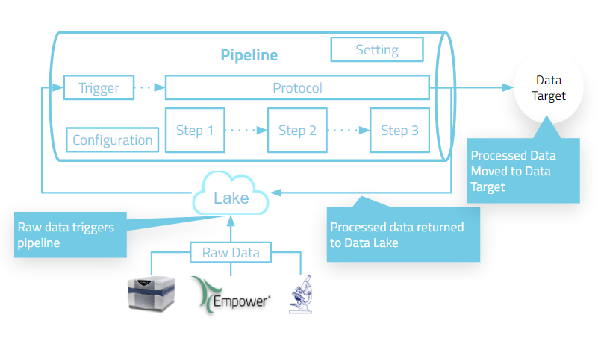
Data Pipeline Architecture

Slide 9
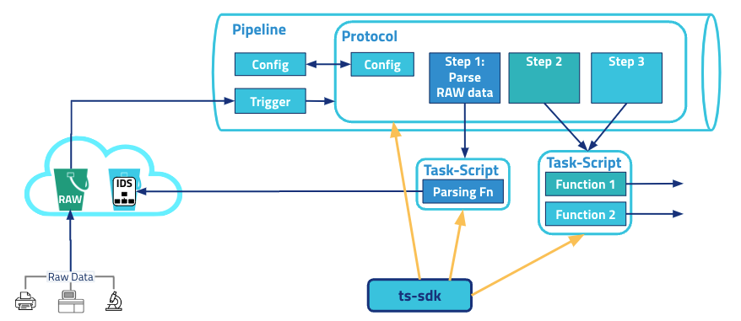
Self-Service Tetra Data Pipelines

Slide 10
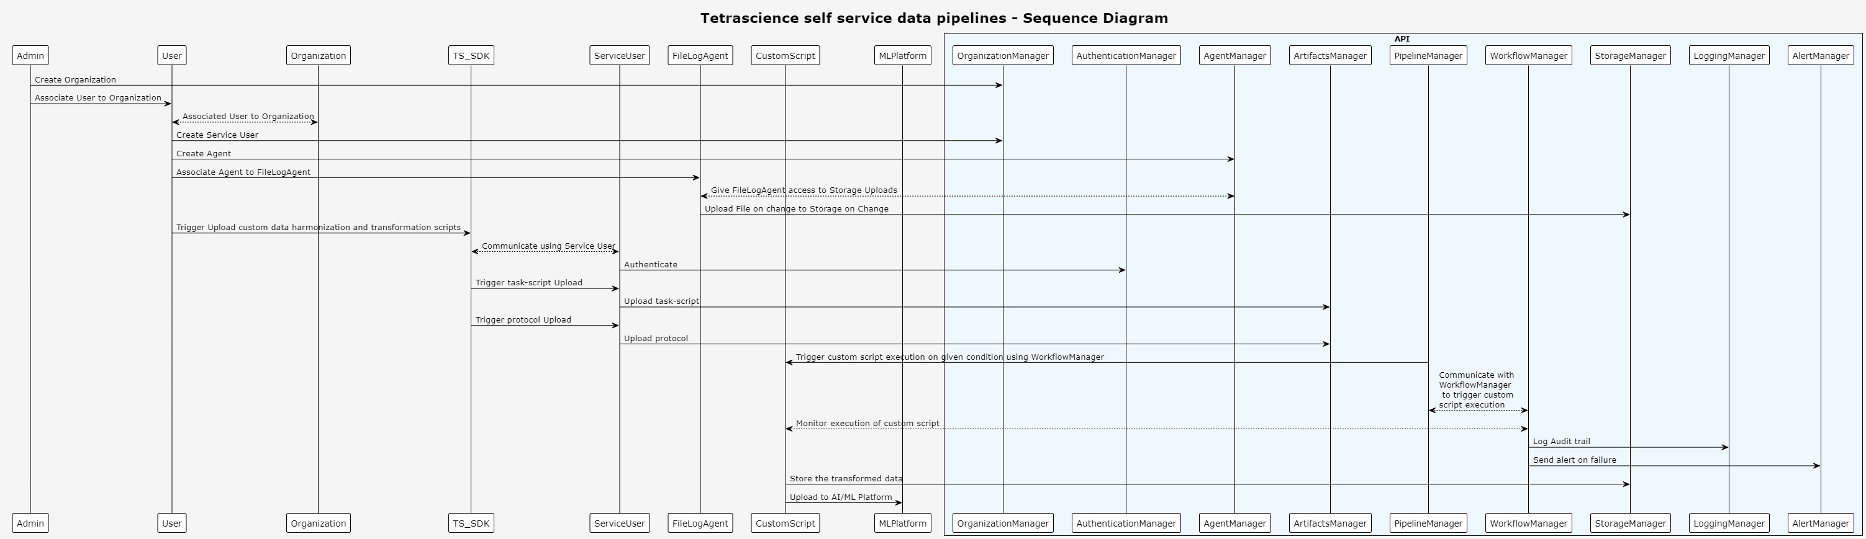
SSP Sequence diagram

Slide 11
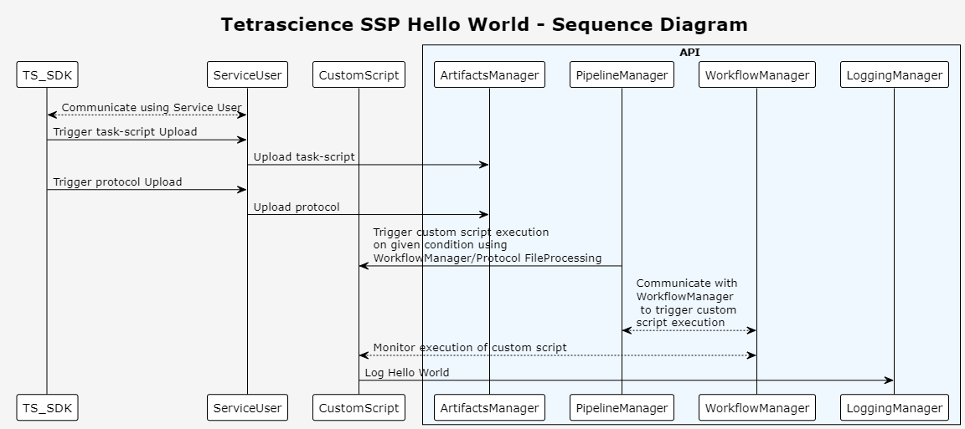
Hello World!

Slide 12
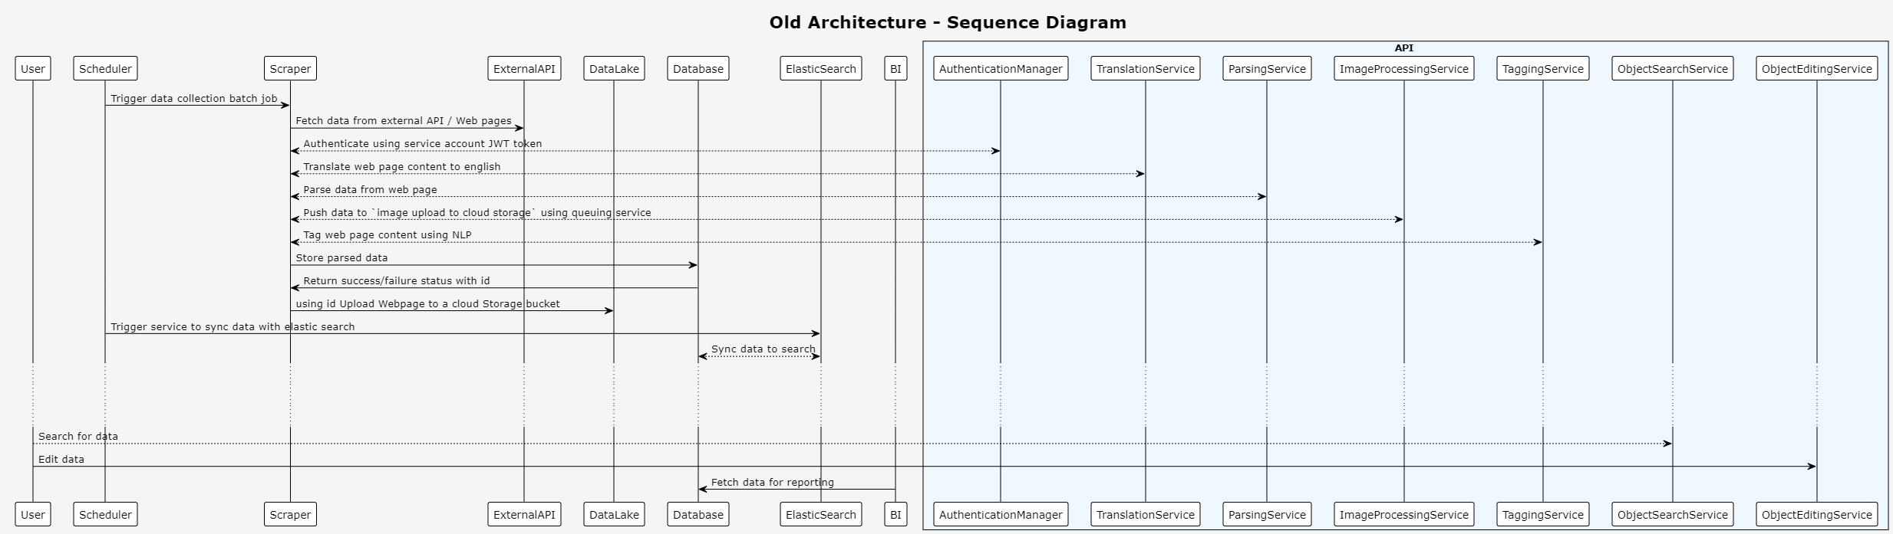
Old Architecture

Slide 13
Desired outcomes
System should be able to scrape websites
Version changes in the content
Translate and parse data
Process images
Create stats and reporting using received data
Tag each object to associated category

Slide 14
Design Tradeoffs or considerations
Adhoc request to load other sources take considerably more time to process.
Breaking changes to the website implies tests failing and a modification in the script.
Consider RAG based LLMs as a service to transform data into desired JSON structure.

Slide 15
Demo
Full history search for patient entry to patient departure
e.g. Diagnostics carcinoma history is related to cancer.
Patient back history
Search capability
Alerts and Pending/Incomplete data warning
Sample analysis

Slide 16
Questions

